Slide 1
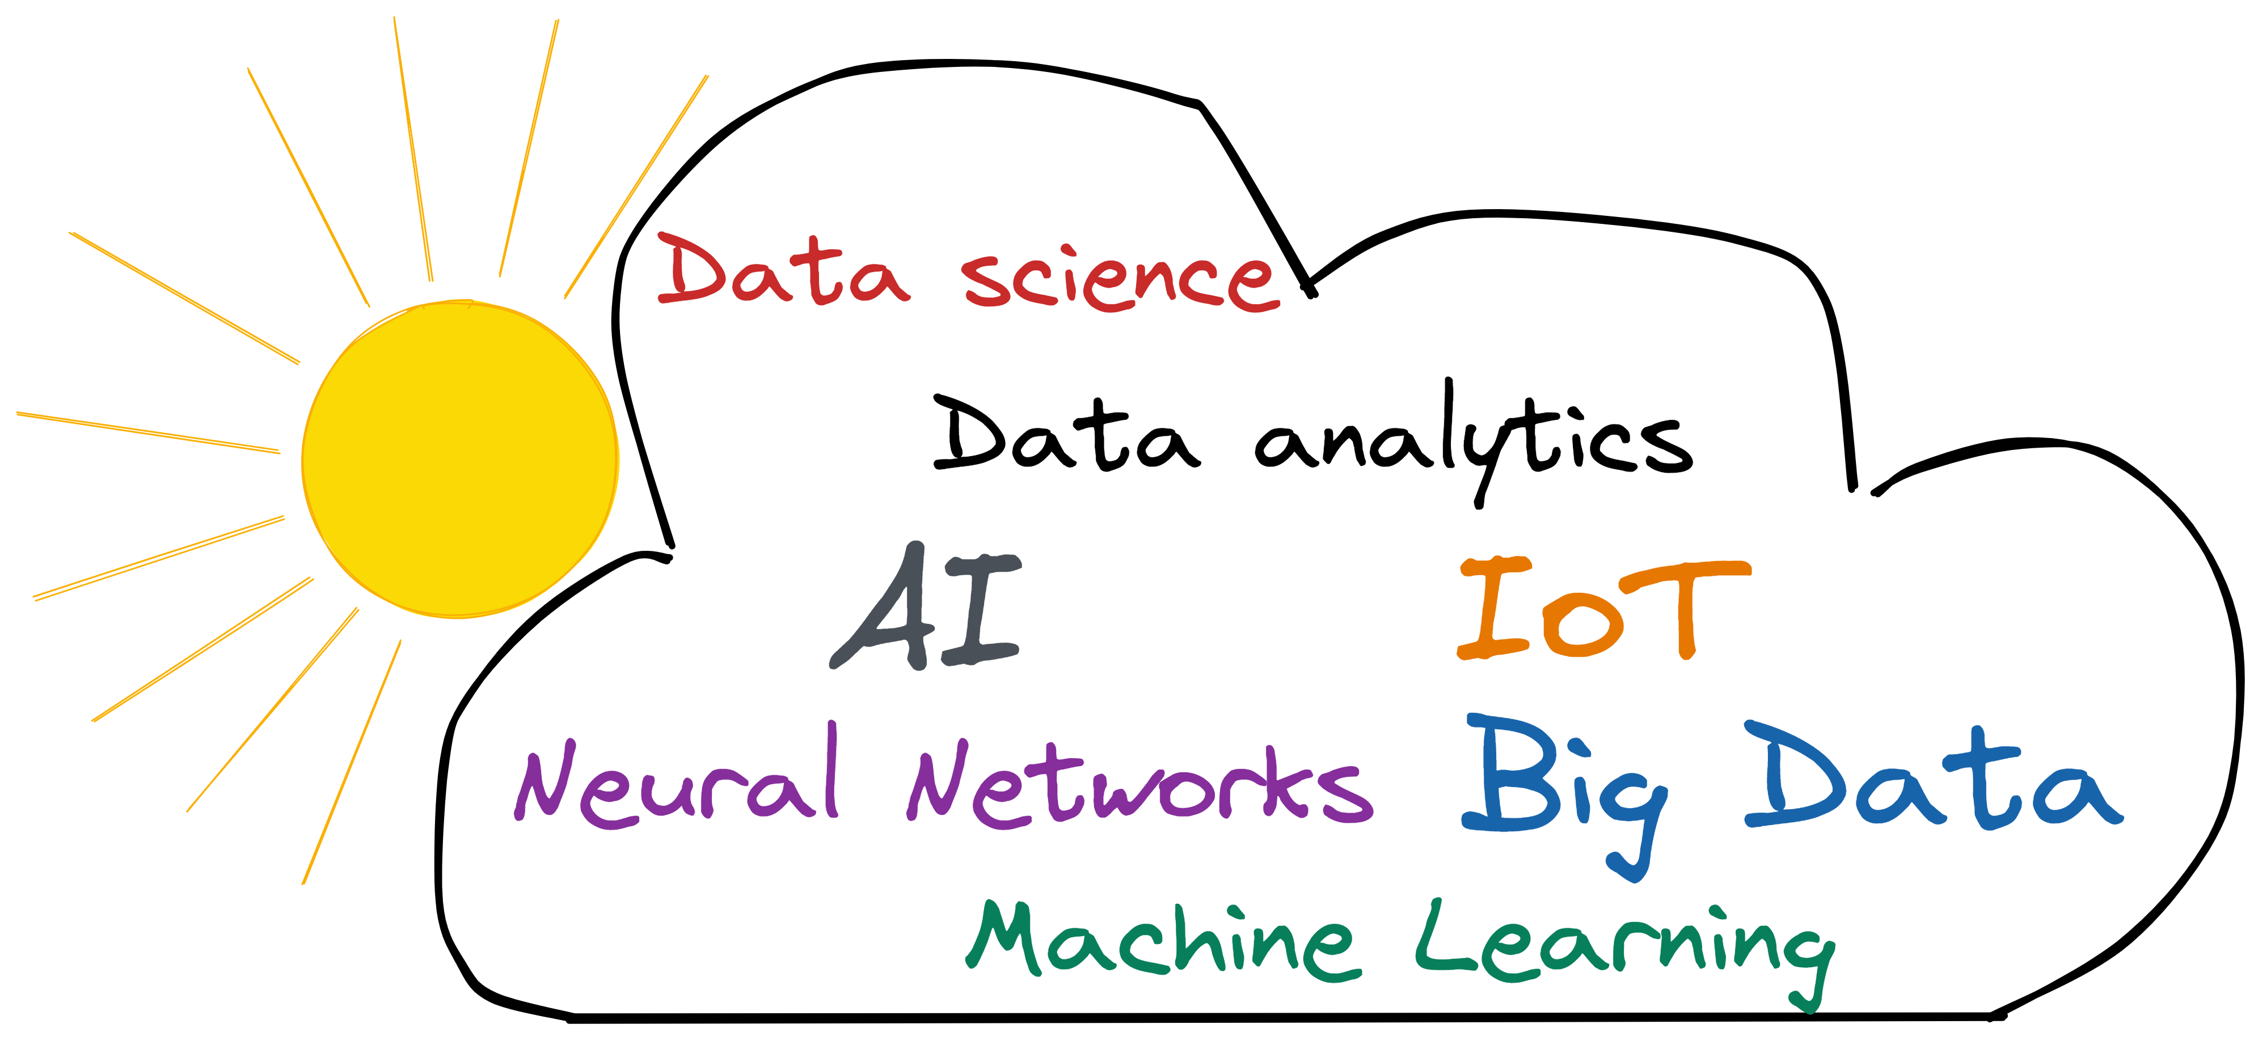
Demystifying Machine Learning
[ IoT- Big Data - Data Science - Machine Learning- Application ]

Slide 2
MODULE OVERVIEW
Broad
Lots of devices
Lots of data
Internet of things
Types of data
What is data?
Big Data
How to gain insights?
Data Science
Insight discovery methods
Machine Learning
Specific

Slide 3



The State of the World
“As of January, 2021, there were 4.66 billion active internet users worldwide (~60% global population).” Most of the websites that are visited have some kind of user tracking- click, scrolling, time spent on a particular section- in order to provide a better surfing experience.
“ Of these, 92.6 percent (4.32 billion) accessed the internet via mobile devices.” Each of these smartphones is recording and reporting important metadata such as user’s location, time/ data stamp, any phone call duration, status (incoming/outgoing/canceled) and type (call/video).
“The number of [wearable] devices are forecast to reach more than one billion by 2022.” The growing interest is the result of these devices (e.g. Apple watch) ability to provide real time data- fitness tracking, heart rate monitoring, fall detection, ECG and blood oxygen reading, … - and reveal critical information to its users and other authorized parties.
“We live in a world that is drowning in data.”- Joel, Grus
Notes:
Insert Link of graphics
- Internet icon
- Smart phone icon
- Smart watch icon

Slide 4
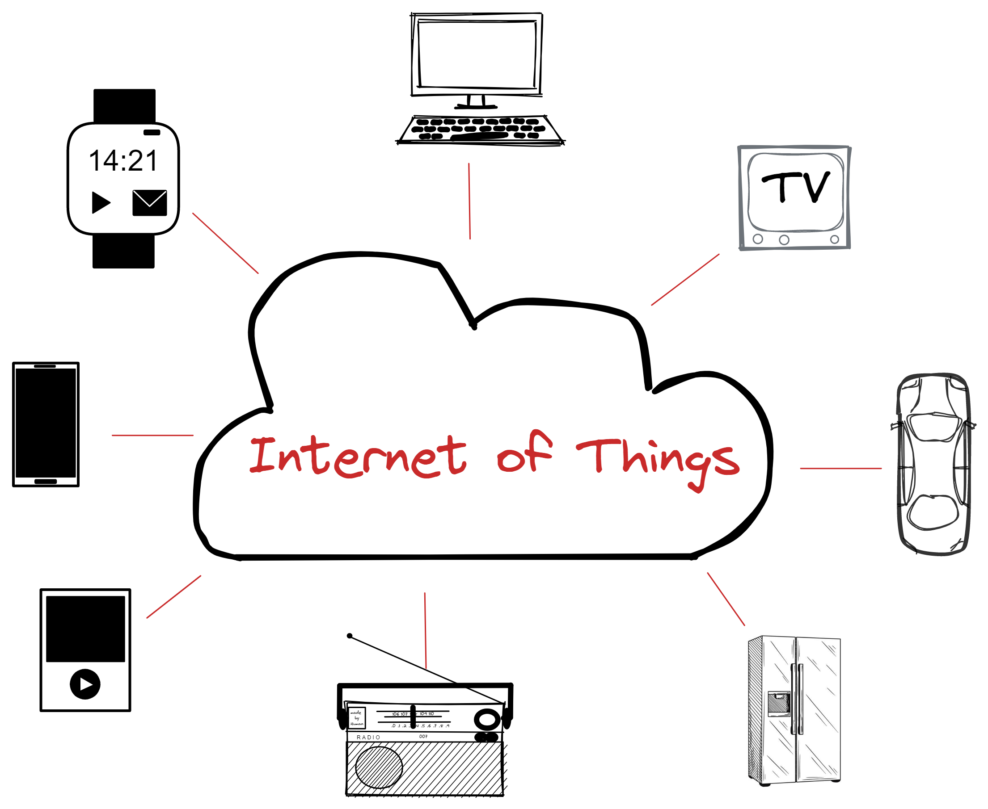
Internet of Things (IoT)
What is IoT?
“The Internet of Things (IoT) describes the network of physical objects—“things”—that are embedded with sensors, software, and other technologies for the purpose of connecting and exchanging data with other devices and systems over the internet.” IoT is about connecting different devices over the internet to share data and enhance the understanding of the “state of the environment” in an automated way.
A “thing” in the Internet of Things can be anything with the capability of generating and sharing data ranging- from smart fridges that can keep track of the consumed food, to self- driving cars that can navigate complex road system, and to irrigation systems that can regulate based on weather conditions.
“The Internet of Things integrates everyday “things” with the internet.”- AWS
Notes:
Other interesting sources
- https://www.ibm.com/blogs/internet-of-things/what-is-the-iot/
- https://internetofthingsagenda.techtarget.com/definition/Internet-of-Things-IoT

Slide 5
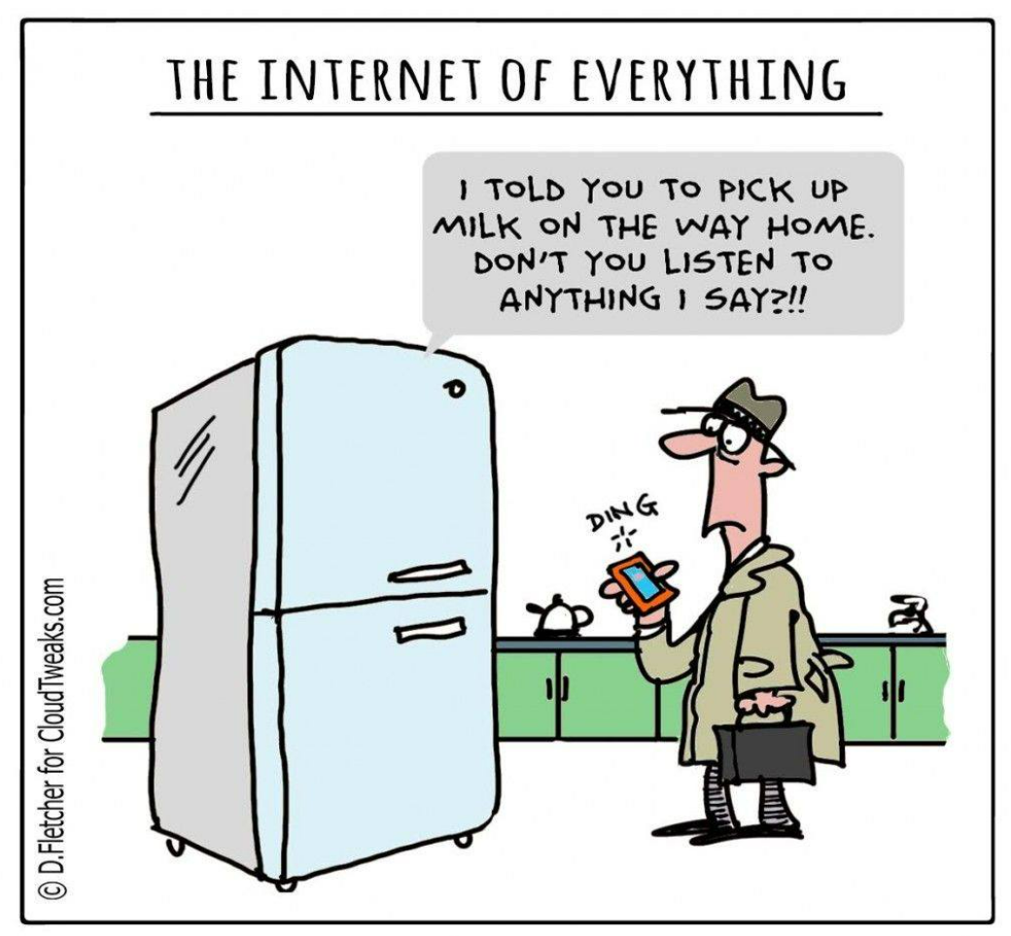
Internet of Things (IoT)
What is IoT?

Slide 6
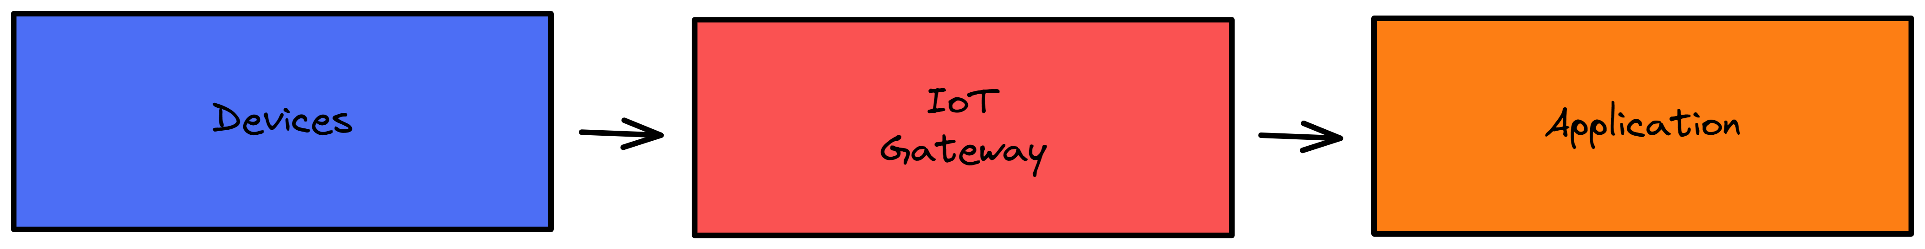
Internet of Things (IoT) - Structure
A typical IoT system consist of a continuous interchange and collection of data in real time between 3 high level components:
Devices, these represent the sensors that are present on the “thing”- television, toaster, fridge, …. - that collect the data and communicate it over the internet.
IoT Gateway, this is an integrating platform, where the data from a device or multiple ones, is pre-processed and reduced to a format that allows for analysis. It is here, with the help of AI and ML that insights are found and transformed into recommendations.
Application, this is what the users see- real time suggestions and controlling power.
Notes:
Check out these resources
https://internetofthingsagenda.techtarget.com/definition/Internet-of-Things-IoT
https://www.ibm.com/blogs/internet-of-things/what-is-the-iot/
https://www.geeksforgeeks.org/architecture-of-internet-of-things-iot/

Slide 7
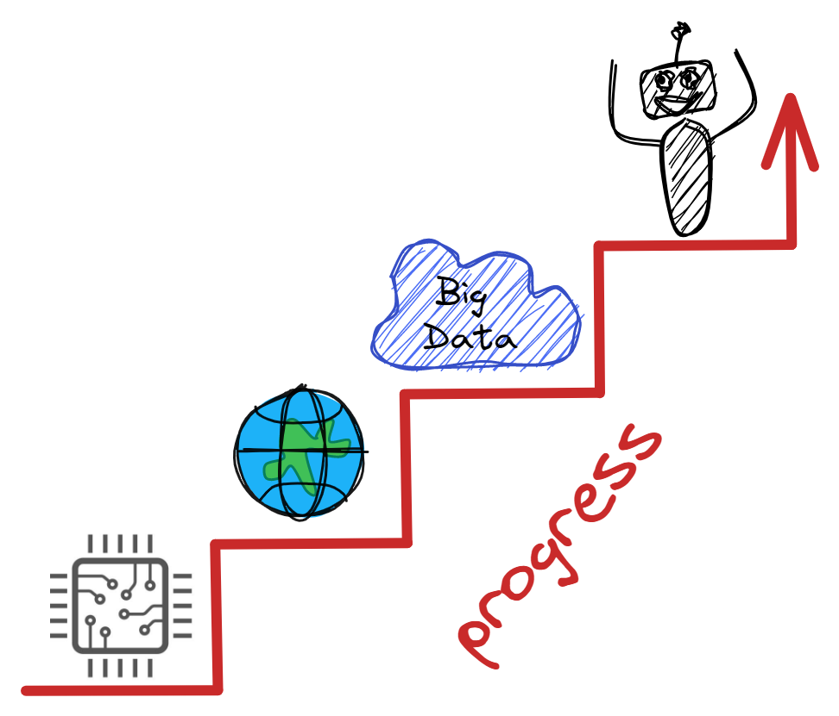
Internet of Things (IoT)
What makes it possible?
The idea of connecting a “thing” to the internet can be back-tracked to as early as 1982, where “a modified Coca-Cola vending machine at CMU became the first ARPANET-connected appliance able to report its inventory and whether newly loaded drinks were cold or not.”
The application and feasibility of such idea has been possible thanks to recent advancements in
Access to low-cost, low-power sensor technology
Robust Internet connectivity
Cloud computing platforms ( i.e. Big Data)
Artificial Intelligence technologies such as Machine learning, Natural Language, and Deep learning models allowing for practical use and common affordability.

Slide 8

Internet of Things (IoT)
What is the point?
"The Internet of Things […] allows machines to do more heavy lifting, take over tedious tasks and make life more healthy, productive, and comfortable." - AWS
Pros
Accelerate innovation
Data to insights
Improved decision making
Optimization and efficiency of processes ( "smarter lives/work")
Cons
Privacy
Security bugs
Scalability issues- many devices and lots of data
Notes:
Cons
- https://internetofthingsagenda.techtarget.com/definition/Internet-of-Things-IoT

Slide 9

Internet of Things (IoT)
Industries
Manufacturing, “production-line monitoring to enable proactive maintenance on equipment” in order to reduce operating costs, and get better uptime.
Automotive, IoT based applications can alert drivers of any “impending equipment failure” and suggest necessary maintenance. In addition, malfunctions can be made known to manufactures and suppliers ensuring effective changes to future productions.
Transportation and Logistics, inventory carriers, such as trucks, ships, and trains, can make use of IoT technologies by taking in account weather conditions, vehicle availability, or driver availability with the intention to find the best route based on real-time conditions.
Retail, IoT can help track and manage inventory shortages through the use of "smart shelves" where automatic tracking allows for alerts when items are running low.
Healthcare, equipment tracking (e.g. wheelchair location)

Slide 10
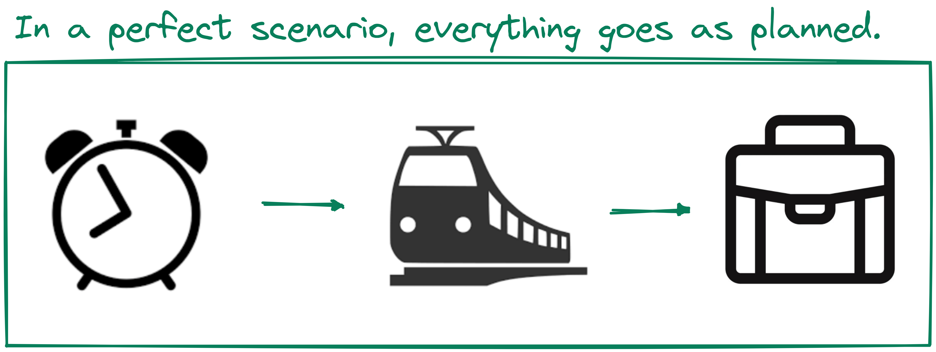
Internet of Things (IoT) - Scenario
"Imagine you wake up at 7am every day to go to work, and do so by train."
Notes:
Imagine you wake up at 7am every day to go to work, and do so by train. Your alarm clock does the job of waking you just fine. That is, until something goes wrong.
Your train’s cancelled and you have to drive to work instead. The only problem is that it takes longer to drive, and you would have needed to get up at 6.45am to avoid being late. Oh, and it’s pouring with rain, so you’ll need to drive slower than usual.
A connected or IoT-enabled alarm clock would reset itself based on all these factors, to ensure you got to work on time. It could recognize that your usual train is cancelled, calculate the driving distance and travel time for your alternative route to work, check the weather and factor in slower travelling speed because of heavy rain, and calculate when it needs to wake you up so you’re not late. If it’s super-smart, if might even sync with your IoT-enabled coffee maker, to ensure your morning caffeine’s ready to go when you get up.

Slide 11
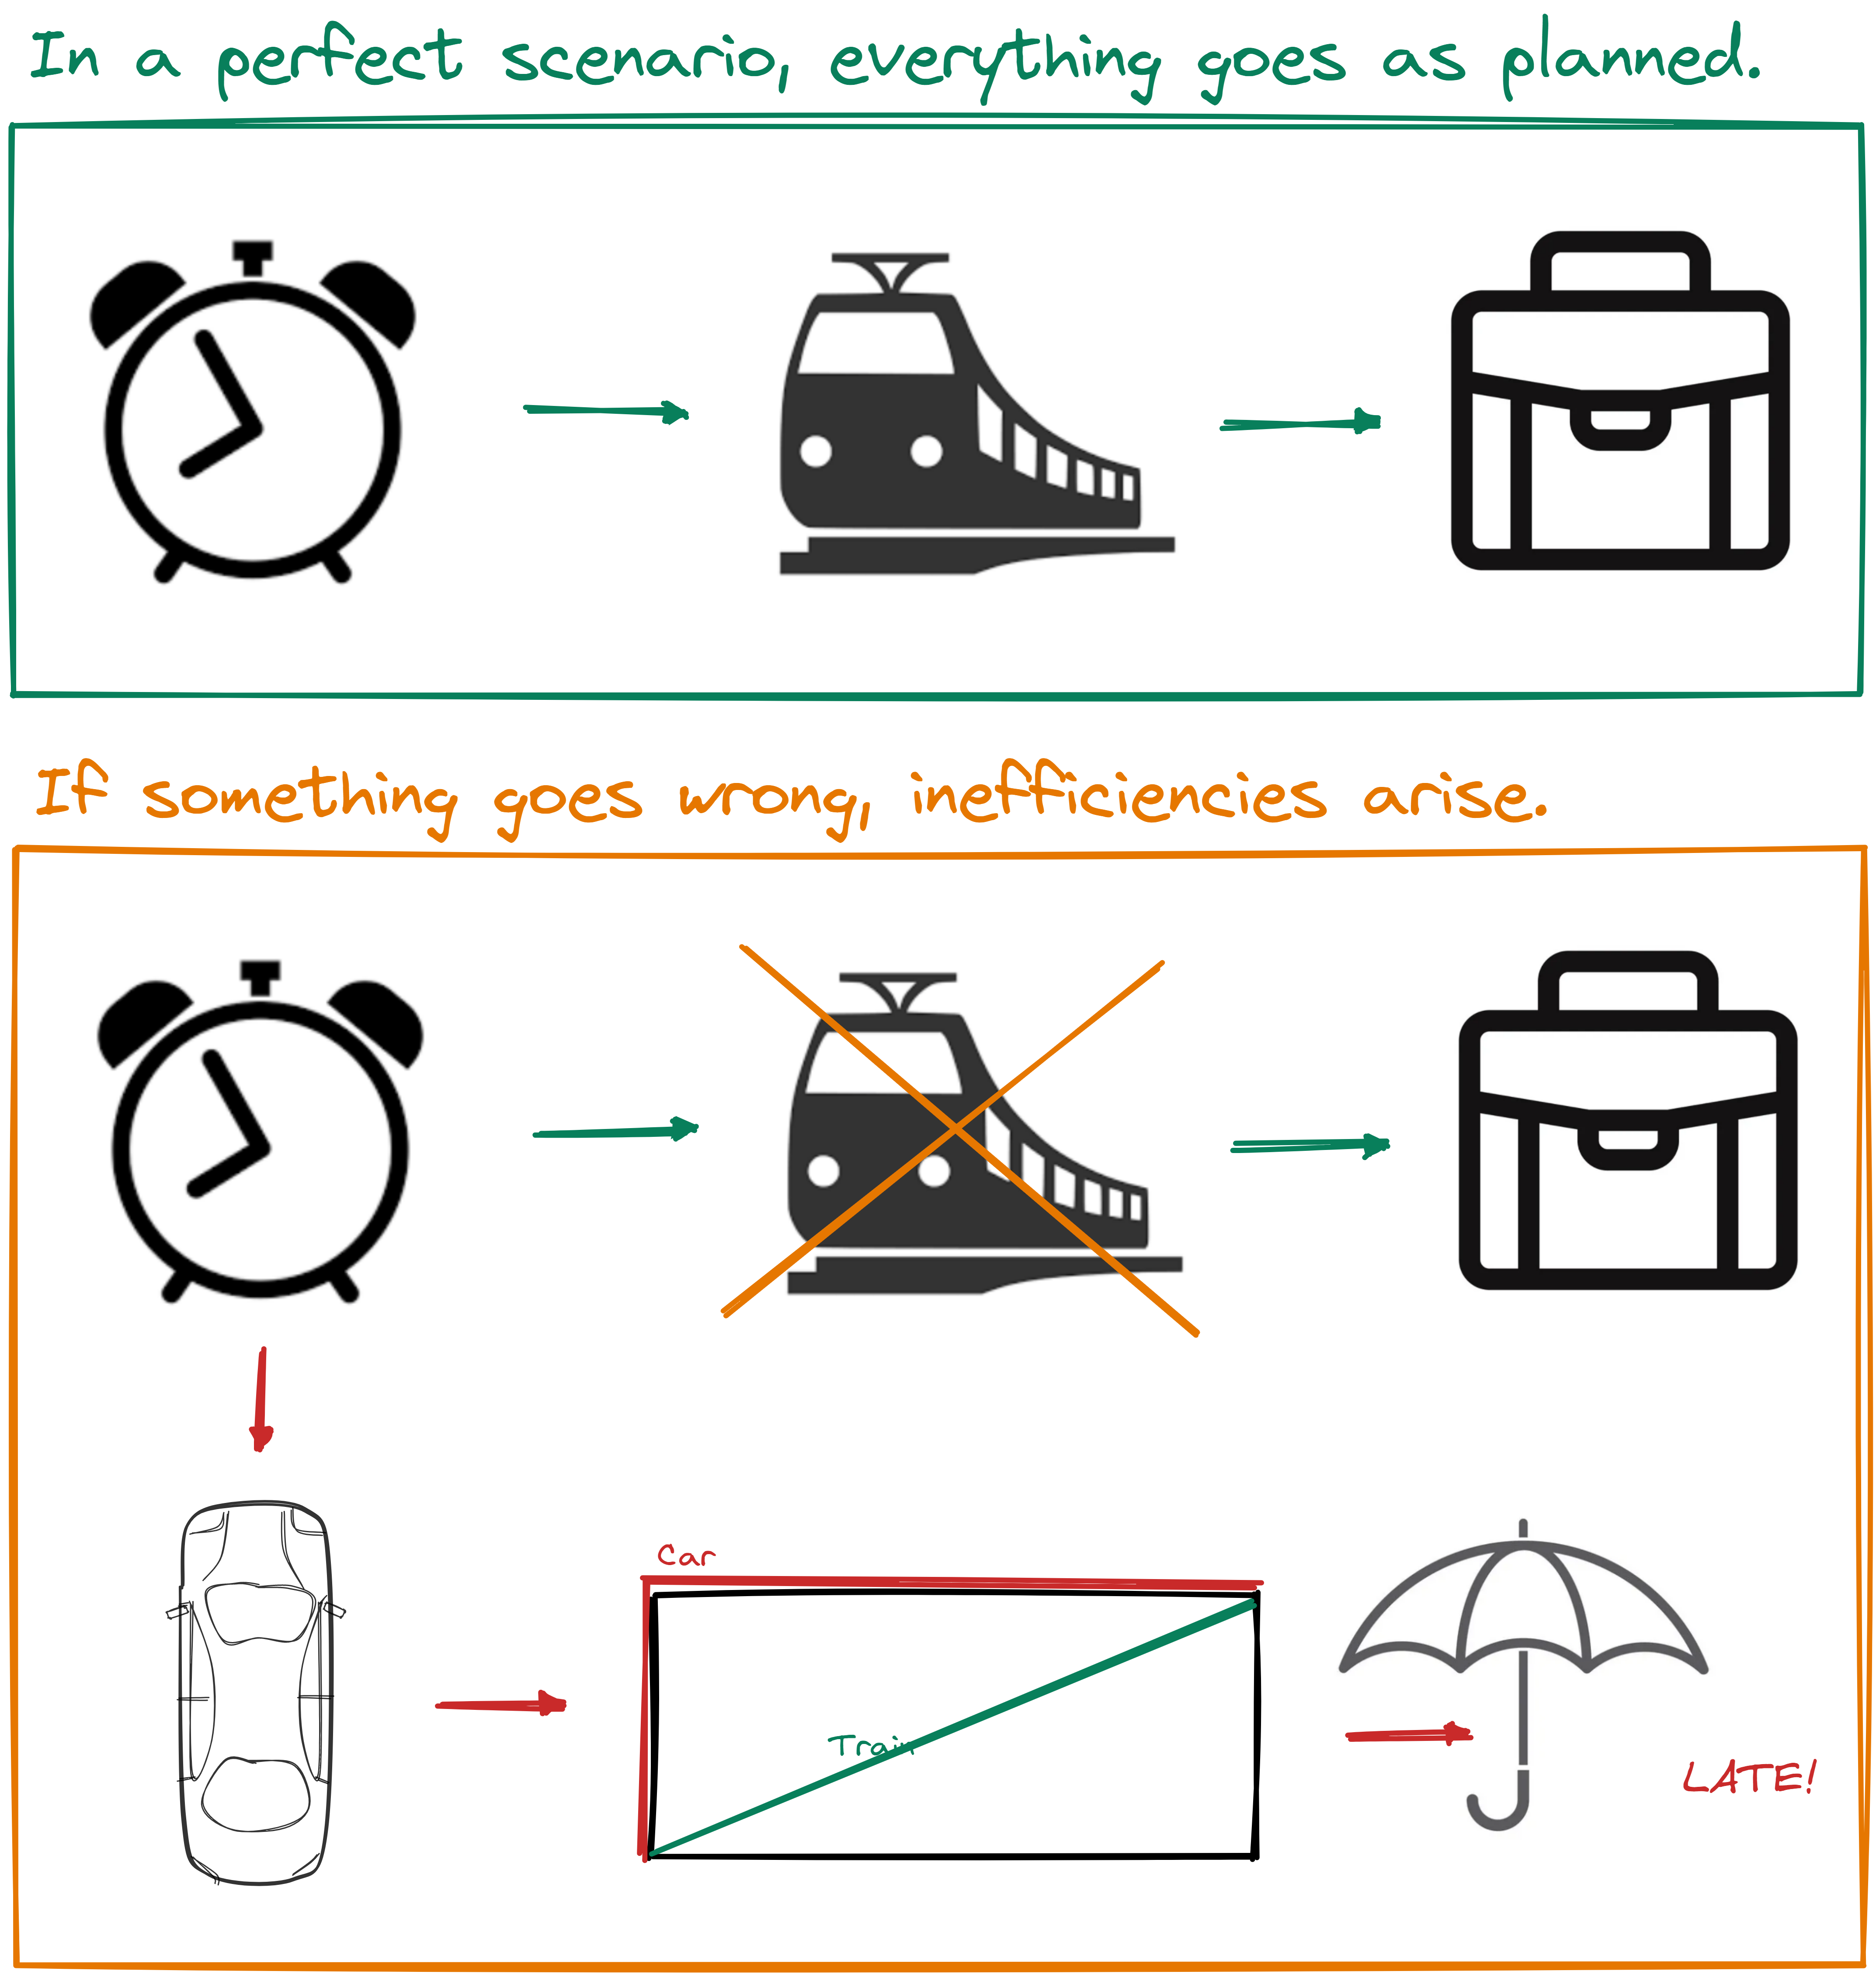
Internet of Things (IoT) - Scenario
"Imagine you wake up at 7am every day to go to work, and do so by train."
Notes:
Imagine you wake up at 7am every day to go to work, and do so by train. Your alarm clock does the job of waking you just fine. That is, until something goes wrong.
Your train’s cancelled and you have to drive to work instead. The only problem is that it takes longer to drive, and you would have needed to get up at 6.45am to avoid being late. Oh, and it’s pouring with rain, so you’ll need to drive slower than usual.
A connected or IoT-enabled alarm clock would reset itself based on all these factors, to ensure you got to work on time. It could recognize that your usual train is cancelled, calculate the driving distance and travel time for your alternative route to work, check the weather and factor in slower travelling speed because of heavy rain, and calculate when it needs to wake you up so you’re not late. If it’s super-smart, if might even sync with your IoT-enabled coffee maker, to ensure your morning caffeine’s ready to go when you get up.

Slide 12
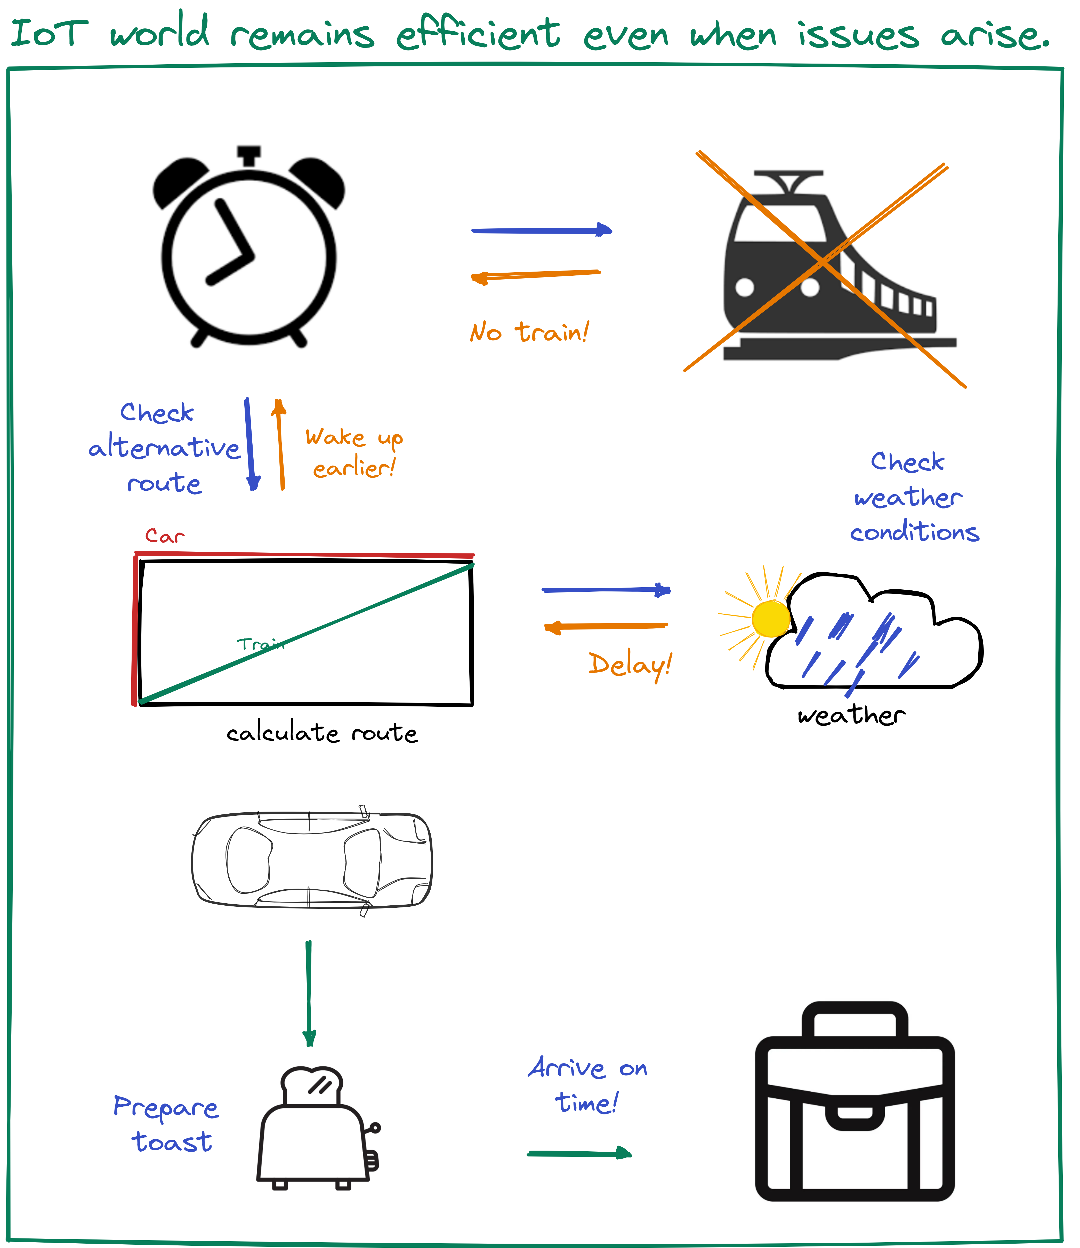
Internet of Things (IoT) - Scenario
"Imagine you wake up at 7am every day to go to work, and do so by train."
Notes:
Imagine you wake up at 7am every day to go to work, and do so by train. Your alarm clock does the job of waking you just fine. That is, until something goes wrong.
Your train’s cancelled and you have to drive to work instead. The only problem is that it takes longer to drive, and you would have needed to get up at 6.45am to avoid being late. Oh, and it’s pouring with rain, so you’ll need to drive slower than usual.
A connected or IoT-enabled alarm clock would reset itself based on all these factors, to ensure you got to work on time. It could recognize that your usual train is cancelled, calculate the driving distance and travel time for your alternative route to work, check the weather and factor in slower travelling speed because of heavy rain, and calculate when it needs to wake you up so you’re not late. If it’s super-smart, if might even sync with your IoT-enabled coffee maker, to ensure your morning caffeine’s ready to go when you get up.

Slide 13
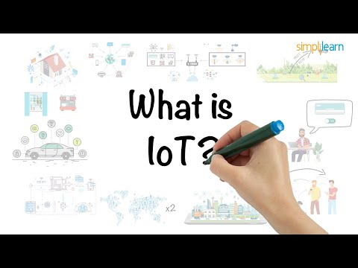
Internet of Things (IoT)
Still Confused?
Watch this video.

Slide 14
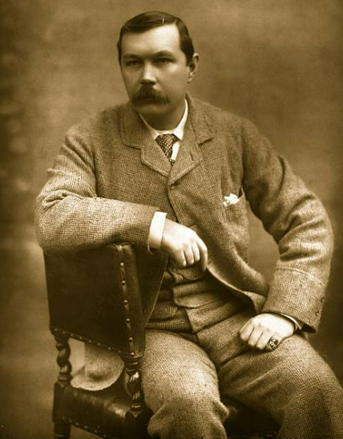
“Data! data ! data!" he cried impatiently. "I can't make bricks without clay.” ― The Adventure of the Copper Beeches - a Sherlock Holmes Short Story
Arthur Conan Doyle

Slide 15
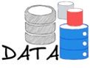
Data, Information or Intelligence?
Wikipedia refers to data as "individual facts, statistics, or items of information, often numeric ... a set of qualitative or quantitative variables about one or more objects" ( [13] Wikipedia, 2021).
Yet, it is not uncommon to stumble upon data defined as information. As a result, one can go further, and make a distinction between data, information, and intelligence, where although related, each component is unique in its nature and scope.
Data, raw measurements that are collected and processed in an intelligible form (e.g. "80 °F")
Information, the results of analyzing data and extracting meaning from it (e.g. "Today is hot")
Intelligence, the ability of using past information and new information to make a useful prediction about the future (e.g. "Apply sunscreen before going out." )
Notes:
Data, raw measurements that are collected and processed in an intelligible form (e.g. "21/11/2021 80 F.")
The dataset; stored in some kind of storage (repository, drive, personal computer, paper, …. )
Information, the results of analyzing data and extracting meaning from it (e.g. "Today is hot")
The article; published in the form of papers in academic journals.
Intelligence, the ability of using past information and new information to make a useful prediction about the future (e.g. "Temperatures for this particular day over the years have been increasing. Hence, the future might be warmer." )
The aftermath; worldwide initiatives where political leaders meet and allow intelligence to drive the world forward.

Slide 16
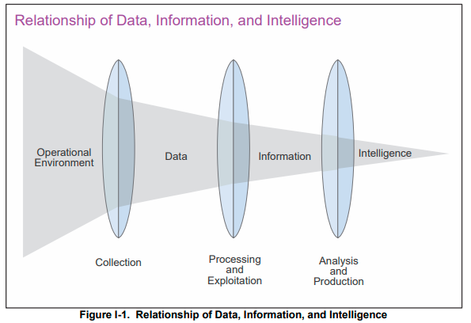
Data
In the current context, the meaning of data is encapsuled by the raw measurements that are collected and eventually used for analysis. These raw measurements represent the essence upon which any subsequential information and intelligence can be inferred.

Slide 17
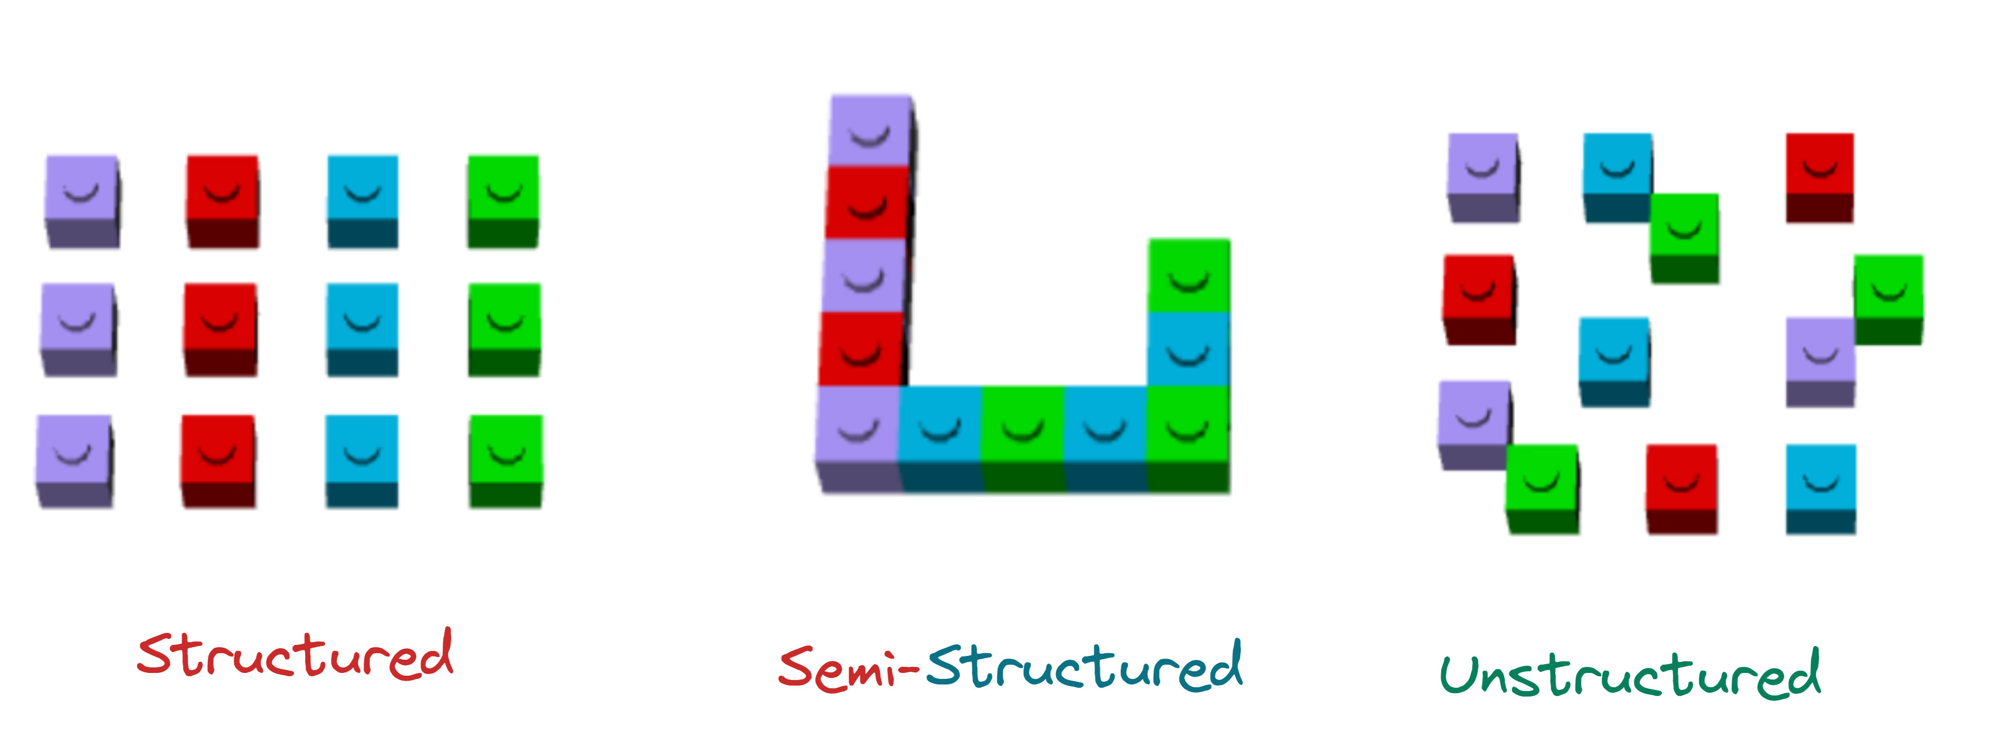
Data – Types
At a high level data can come into three forms: structured, semi-structured, and unstructured.
Structured data is highly organized data that exists within a repository such as a database or a comma-separated values (.CSV) file where data is easily identifiable (e.g. column and rows) and accessible (e.g. queries and analysis). In most cases, structured data is more of an end product of pre-processing phases, rather than a “natural occurrence.” Its value resides in the fact that it can be immediately analyzed.
Semi-structured data is a hybrid (bridge) between structured and unstructured where there are present metadata and similar semantical hierarchies that make pre-processing more efficient.
Unstructured data lacks any content structure at all (e.g. a collection of words), and as a result it cannot be immediately analyzed. Although, most data have some inherent structure (e.g. metadata), the present structure is not enough to warrant readily usable status.

Slide 18
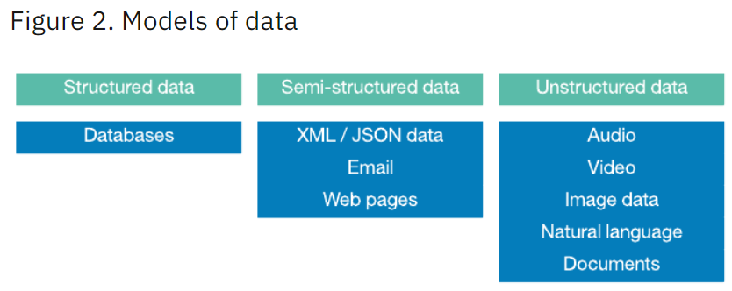
Data – Types
"The rule-of-thumb is that structured data represents only 20% of total data. Most of the data in the world (80% of available data) is unstructured or semi-structured." - IBM
Source: IBM
Notes:
Very good examples also at
https://k21academy.com/microsoft-azure/dp-900/structured-data-vs-unstructured-data-vs-semi-structured-data/

Slide 19
Data – Types
Structured Example
Notes:
Very good examples also at
https://k21academy.com/microsoft-azure/dp-900/structured-data-vs-unstructured-data-vs-semi-structured-data/

Slide 20
Data – Types
Semi-Structured Example
Notes:
Very good examples also at
https://k21academy.com/microsoft-azure/dp-900/structured-data-vs-unstructured-data-vs-semi-structured-data/

Slide 21
Data – Types
Unstructured Example
Notes:
Very good examples also at
https://k21academy.com/microsoft-azure/dp-900/structured-data-vs-unstructured-data-vs-semi-structured-data/

Slide 22
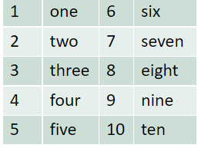
Data – Types
Furthermore, the data (i.e. raw measurements) can be categorized according to their "nature."
Quantitative (a.k.a. numeric) data "refers to any information that can be quantified, counted or measured, and given a numerical value."
Continuous, any value in an interval/range (e.g. height, pi)
Discrete, a countable and distinct list of values ( e.g. integers & whole numbers)
Qualitative (a.k.a. categorical) data "is descriptive in nature, and expressed in terms of language rather than numerical values." It places an item into one or several categories.
Binary, only two possible categories (mut. exclusive) are present (e.g. 0/1, "Yes"/"No")
Ordinal, the categories have an ordering or rank (e.g. small, medium, large)
Nominal, the categories have no inherent order or ranking (e.g. red, blue, green)
Notes:
Further Resources
Quantitative vs Qualitative
https://www.youtube.com/watch?v=4iws9XCyTEk&t=2s
Discrete vs Continuous
https://www.youtube.com/watch?v=bRr8zDOkh9o&t=271s
"Broadly speaking, when you measure something and give it a number value, you create quantitative data. When you classify or judge something, you create qualitative data. So far, so good. But this is just the highest level of data: there are also different types of quantitative and qualitative data."
https://blog.minitab.com/en/understanding-statistics/understanding-qualitative-quantitative-attribute-discrete-and-continuous-data-types . 1
Ch.1 & Ch. 4
https://open.umich.edu/find/open-educational-resources/statistics/statistics-250-introduction-statistics-data-analysis#labs
Google Expert
https://towardsdatascience.com/how-many-data-types-can-you-name-a5f8869066ca

Slide 23
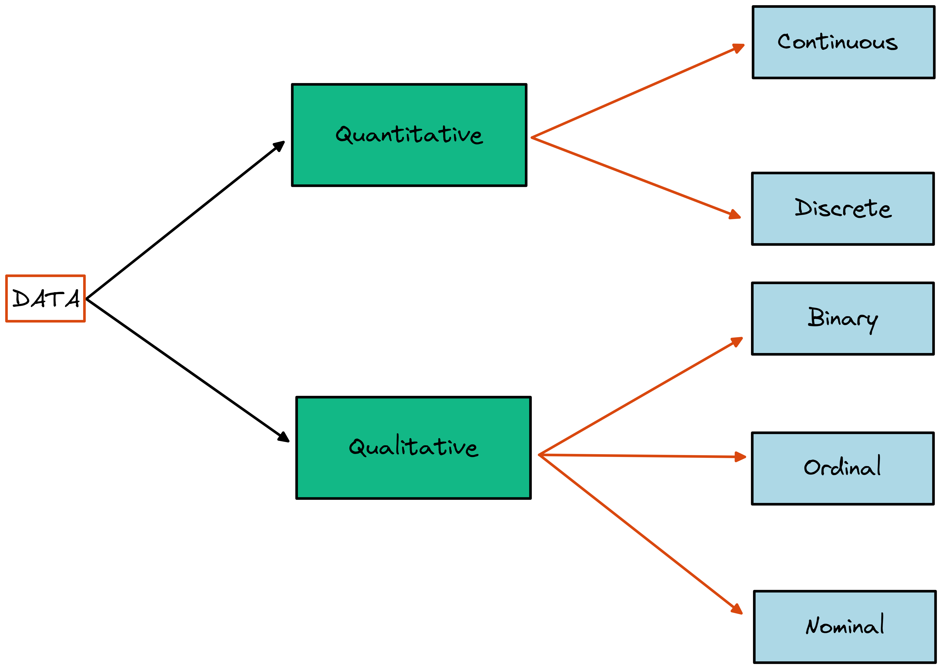
Data – Types

Slide 24
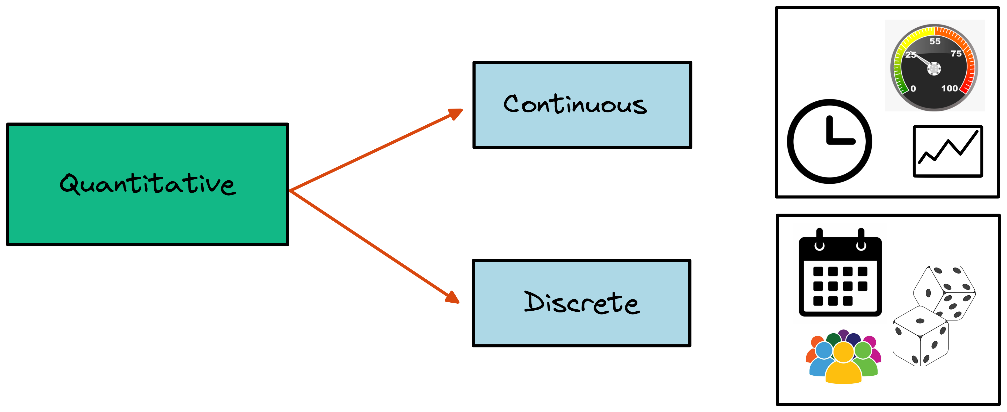
Data – Types
Notes:
Examples < https://www.mygreatlearning.com/blog/types-of-data/ >

Slide 25
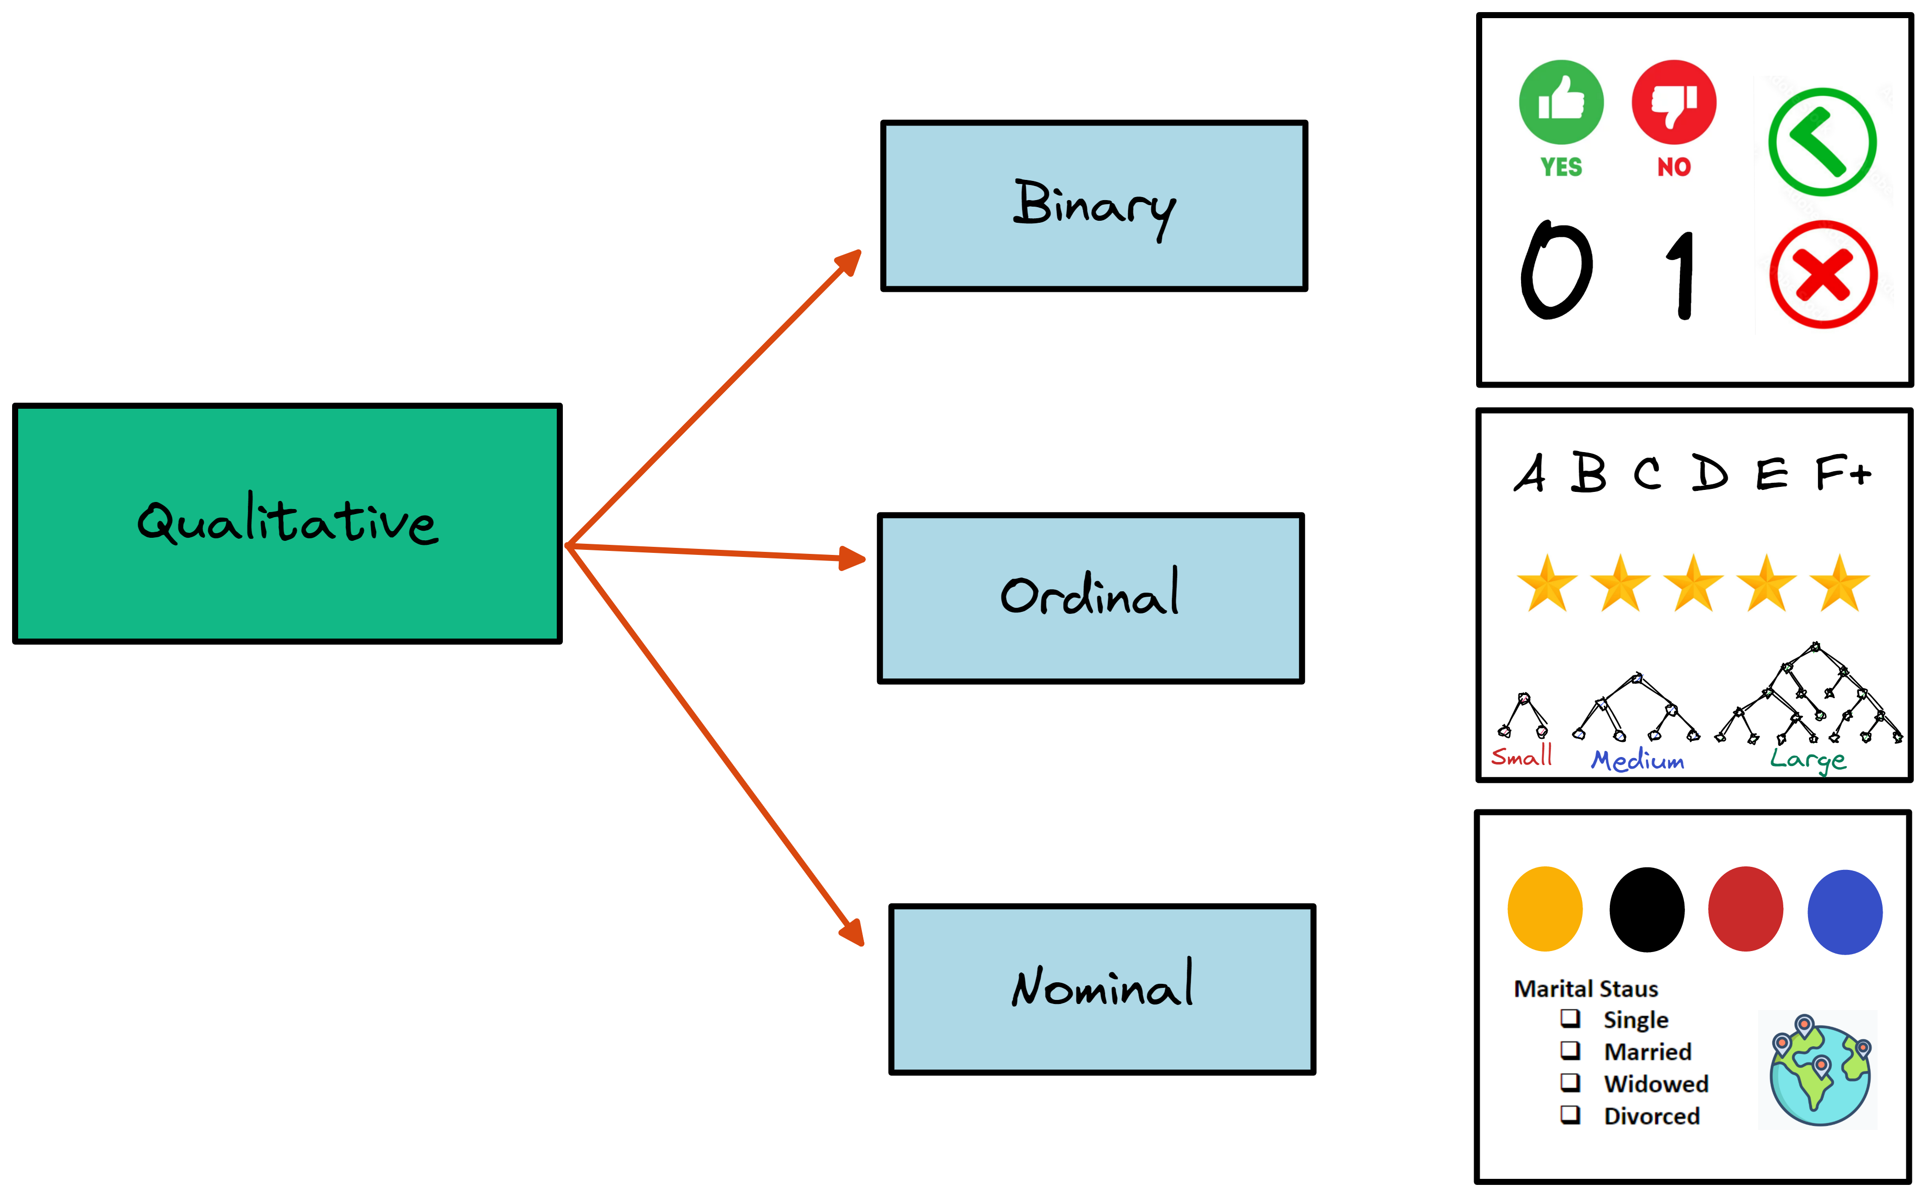
Data – Types
Notes:
Examples < https://www.mygreatlearning.com/blog/types-of-data/ >

Slide 26
"The data type is important to help determine the type of visual display, data analysis, or statistical model. Also, data types determines how software handles computations." - Practical Statistics for Data Scientist by Peter & Andrew Bruce

Slide 27

Data – Types
Still Confused?
Watch this video.
Normal Stats with Dr. Christina

Slide 28



Big Data
A term that has emerged as a result of the continuous generation of data is "Big Data." One hears it in the news, at work, school, and maybe even at the dinner table. But what exactly is behind this fancy term? Let us explore some examples and then go more in-depth about its definition and components.
Some Examples
In 2008, Google declared that its search engine had indexed about 1 trillion web pages, for reference this would be “equivalent to exploring every intersection of every road in the United States 50,000 times.”- Google
“As of February 2020, more than 500 hours of video were uploaded to YouTube every minute. This equates to approximately 30,000 hours of newly uploaded content per hour.” – Statista
“Walmart handles more than 1M transactions per hour” - Cukier 2010
Notes:
This report is a very good resource for maybe better examples and outlooks.
https://www.seagate.com/files/www-content/our-story/trends/files/idc-seagate-dataage-whitepaper.pdf
Suggested by HBs
https://www.domo.com/solution/data-never-sleeps-6

Slide 29
Big Data
Moore's Law
In 1965 Gordon Moor proposed an observation, today known as Moore's Law, in which he predicted that “the number of transistors in a dense integrated circuit (IC) would double about every two years.”
Although, it is not a physical law in itself, it seems to hold on over time and it has been applied to other aspects of computing as well to make forecasts and predictions
With a society that is becoming more and more dependent on technology, the rate of growth of data has been increasing exponentially over time.
"The growth rates of data volumes are considered faster than Moore’s Law, with data volumes more than doubling every eighteen months.”

Slide 30
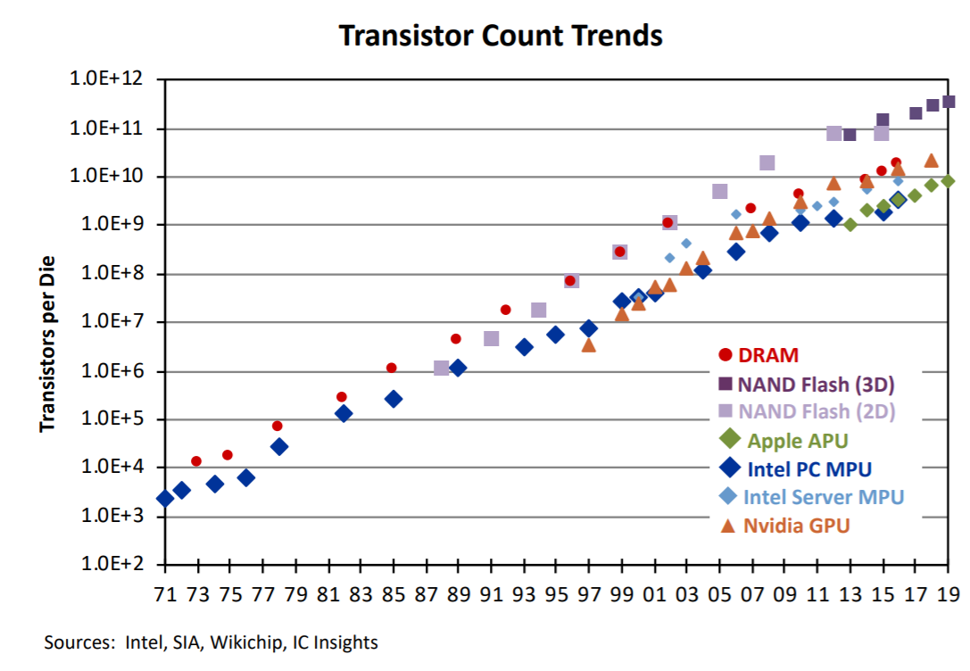
Big Data
Moore's Law
"Though growth rates in some product categories have slowed, doubling of transistors per chip every two years remains a guideline that the industry continues to follow." - IC Insights

Slide 31
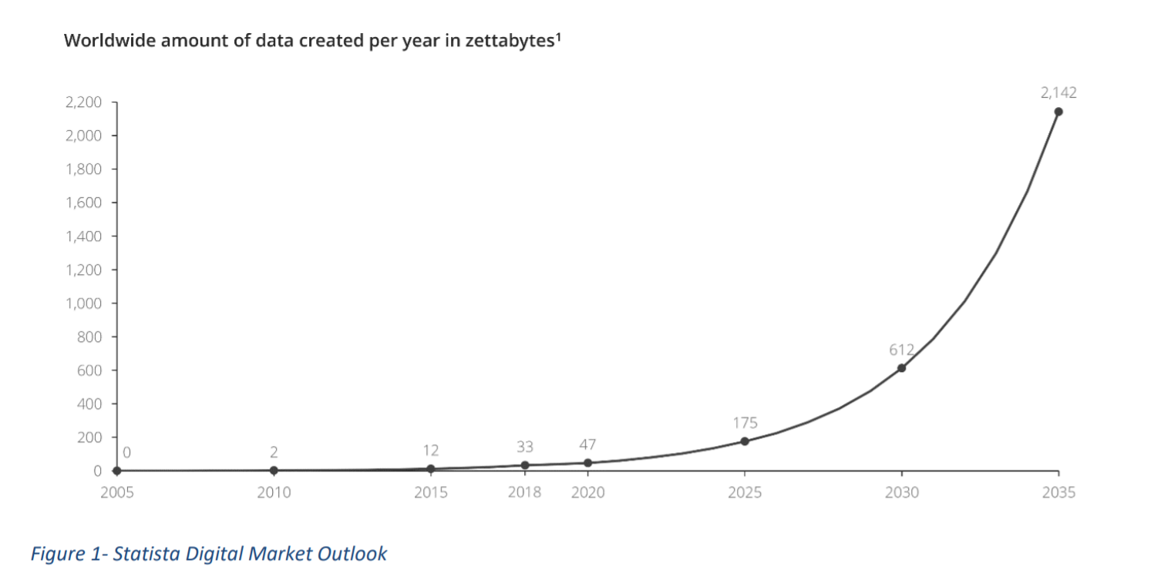
Big Data
Replace graph with better one!
Data Growth
"The total amount of data created, captured, copied, and consumed globally is forecast to increase rapidly, reaching 64.2 zettabytes in 2020. Over the next five years up to 2025, global data creation is projected to grow to more than 180 zettabytes." - Statista
Notes:
https://www.seagate.com/files/www-content/our-story/trends/files/idc-seagate-dataage-whitepaper.pdf

Slide 32
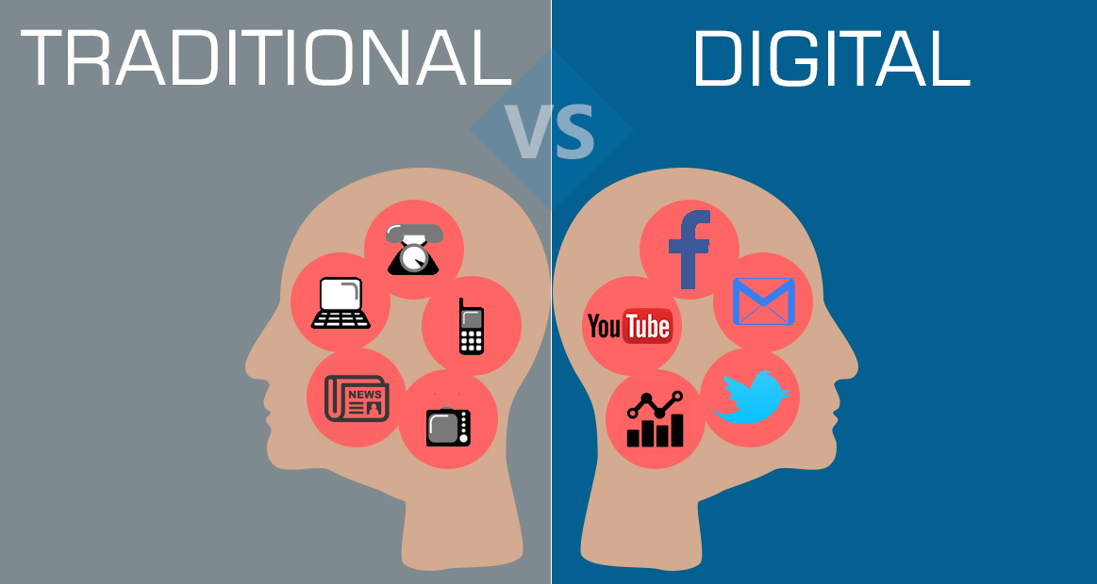
Big Data
The exponential growth of data has fostered progress in the data extraction methods enhancing the discovery of valuable information and new opportunities. At its core, the major benefit of Big Data is the ability to be able to process large quantity of it and extract as much valuable information as possible.
Yet, there are fundamental challenges with traditional infrastructures that hinder the ability to process and analyze the diverse kinds of data that are generated. “One significant shift is in the amount of unstructured data; recently, the quantity of unstructured data, such as micro-texts, web pages, relationship data, images and videos, has exploded, and the trend indicates an increase in the incorporation of unstructured data to generate value.”
“Big Data represents a fundamental change in the architecture needed to efficiently handle current datasets.”

Slide 33
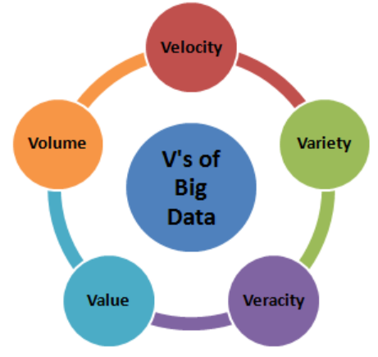
Big Data – The V's of Big Data
Big Data refers in principle to the limitation that traditional data architectures face when dealing with the today's generated data. Specifically, these limitations revolve around
Volume, the size of the dataset
Velocity, the rate of flow
Variety, data can come from different repositories, domains, and be of structured ( database) or unstructured (emails, video, pictures, social media posts, … )
Veracity, the quality of the source and the eventual truth of data
Variability, the differences in meaning and semantics from diverse sources
Big Data "consists of extensive datasets- primarily in the characteristics of volume, variety, velocity, and/or variability- that require a scalable architecture for efficient storage, manipulation, and analysis."
Notes:
Doug Laney original (3V's) in the 2000's
Read upon this as explaining.
https://datasciencedegree.wisconsin.edu/data-science/what-is-big-data/
Additional V (visualization, value)- Big Data is an ongoing progress.

Slide 34

Big Data – Benefits
Big data has the power of providing insights that are buried deep in the data and that might be too elusive to catch to even the an expert eye. The domains and use cases extend to all walks of life allowing for better decision and outcomes resulting in an improved society.
Cost reduction, data science techniques and cloud-based Servies bring significant cost advantages when it comes to storing large amounts of data.
Better Decisions, state of the art analytics, combined with the right data infrastructure, businesses can find insights in real time and make impactful decisions.
Innovation, With the ability to gauge customer needs and satisfaction through analytics comes the power to give customers what they want.
"The importance of big data doesn’t simply revolve around how much data you have. The value lies in how you use it." - SAS
Notes:
Mention some real world examples.
https://datasciencedegree.wisconsin.edu/data-science/what-is-big-data/

Slide 35

Big Data – Pipeline
What is a Data Pipeline?
In the traditional setting, a data pipeline “is a means of moving data from one place (the source) to a destination (such as a data warehouse). ”
Data pipelines consist of three key elements: a source, a processing step or steps, and a destination. The source specifies the origin of the data, the processing steps allow for an appropriate format congruent with systems/user requirements, and the destination symbolize the location of the end data product, where it can be retrieved and analyzed.
In the current context, the term data pipeline will be used to represent the different steps and methods that the data undergoes, so as to be analyzed and turned into insight (i.e. workflow).

Slide 36
Big Data – Pipeline
Anyone can reap the benefits of the infrastructures and technologies behind Big Data; this in turn requires a plan with a clear strategy.
Set a big data strategy, goal oriented initiatives are better than shots in the dark.
Identify big data sources, whether incoming data, social media, or publicly available data, it is imperative to have clear sources with potentially useful data.
Store big data, a modern infrastructure capable to handle demanding tasks.
Analyze the data with the aid of Artificial Intelligence & Machine Learning.
Make intelligent, data-driven decisions and enjoy better outcomes.
Notes:
Further notes
https://www.sas.com/en_us/insights/big-data/what-is-big-data.html
Data sources: common data sets for statistical analysis include Internet of Things (IoT) sensors, census data, public health data, social media data, imagery data, and other public sector data that benefit from real-world predictions.

Slide 37
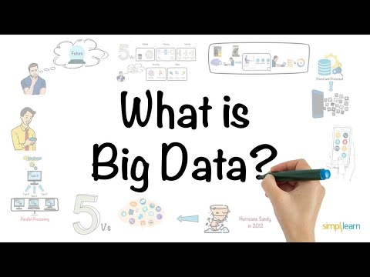
Big Data
Still Confused?
Watch this video.

Slide 38
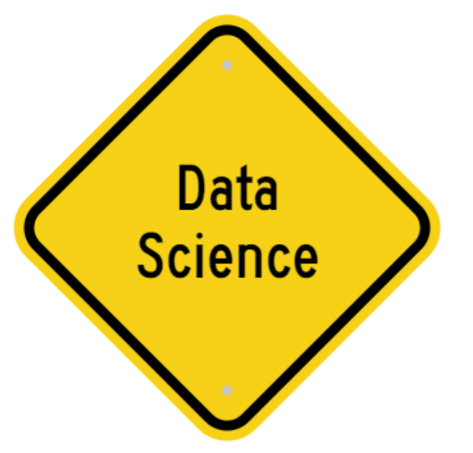
Data Science
Data Science to the Rescue
There is a "sea" of data- sensors, text images, videos,…- one can only dream of the possible insights that can be gathered, yet, the dream can turn into a nightmare for getting lost in such vastness is not a distant reality.
The key of Big Data relies in the ability to unlock its power by transforming the vast "sea" of raw unstructured data into actionable insights!
This becomes a reality with the ideas, methods, process, and tools stemming from data science, which itself is a combination of multiple fileds and domains. Data science allows for raw data to go through phases of cleaning and processing with the intention to bring forth a structured form and eventually be analyzed and turned into "gold."
"Data science is the extraction of actionable knowledge directly from data through a process of discovery, or hypothesis formulation and hypothesis testing."
Notes:
Mention IoT - Internet of things.

Slide 39
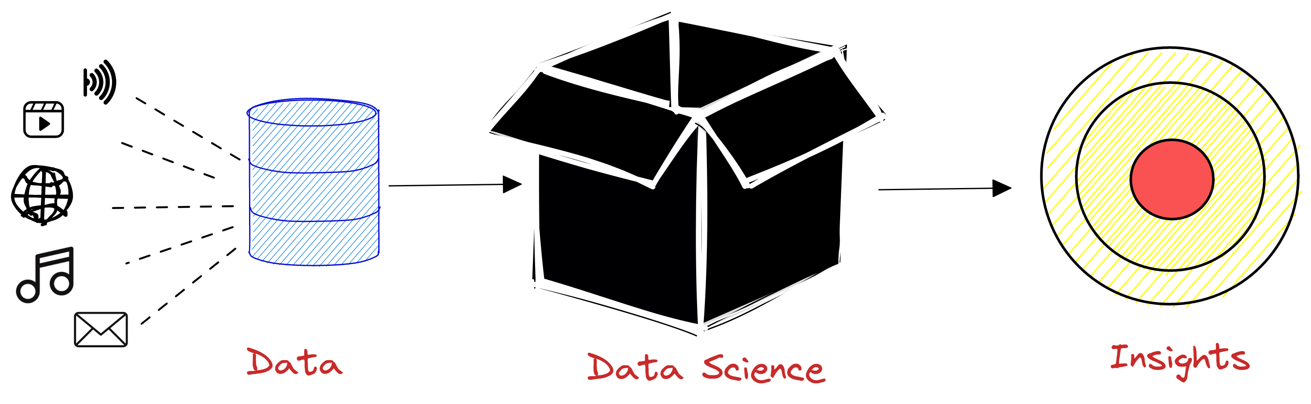
Data Science
Intuition
Notes:
Further Notes
Discuss what the major point are in here.
http://drewconway.com/zia/2013/3/26/the-data-science-venn-diagram
https://excalidraw.com/#room=adc8e9fbbc1d5149cc44,yQ8wfFWtHJyDCMnlc3chmA

Slide 40
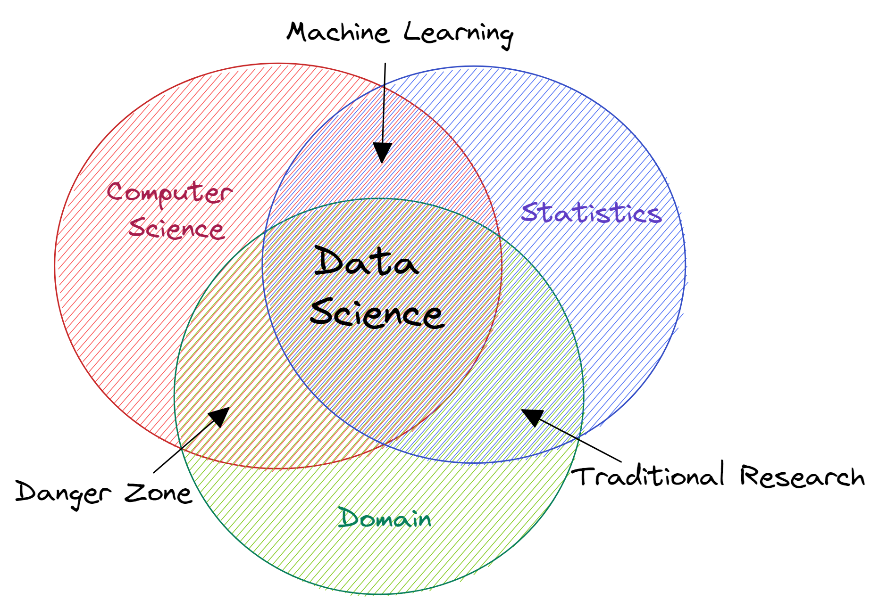
Data Science
"A data scientist is someone who knows more statistics than a computer scientist and more computer science than a statistician." - Josh Blumenstock
It is a diverse field, comprising professionals (software engineers, statisticians, machine learning experts, …) from different walks of life, all with the shared goal of extracting insights from data.
Inspired by Drew Conway
Notes:
Discuss what the major point are in here.
http://drewconway.com/zia/2013/3/26/the-data-science-venn-diagram

Slide 41
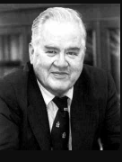

Data Science
History
Many of the ideas implemented in data science, are rooted in ideas stemming from modern statistics; for most part (in the past) statistics focused mainly on inference- a framework for "drawing conclusion about large populations based on small samples."
In 1962, John W. Tukey published a paper- "The future of Data Analysis"- where he called for a reformation of statistics suggesting a new discipline called data analysis that included inference as one component in a series of the steps. One interesting feature of the discipline suggested by Tukey was the connections made by data analysis to the engineering and computer science communities.
Another interesting reference is C.F. Jeff Wu used the term Data Science to describe statistics, in a lecture at the Chinese Academy of Sciences.
Tukey
Wu
Check this article for more history/better history?
Notes:
Tukey's Paper
https://projecteuclid.org/journals/annals-of-mathematical-statistics/volume-33/issue-1/The-Future-of-Data-Analysis/10.1214/aoms/1177704711.full

Slide 42
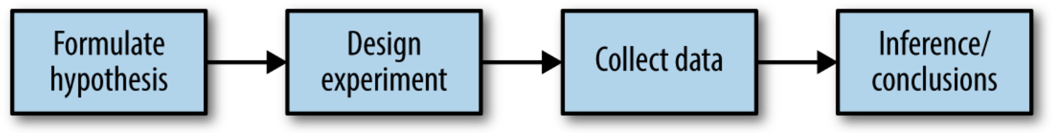
Data Science
Classical Statistical Inference Pipeline
Similar to the scientific method, the traditional ways of statistical inference begin with an hypothesis —“drug A is better than the existing standard drug." An experiment is designed to test the truth of the hypothesis— "a comparison between the groups of interest is carried out with the intention to find the best one (A/B testing)." The data is collected and analyzed — "measure any particular benefits and side effects and report findings, similarities, difference." Finally, based on the data determine the appropriate conclusion.
"The term inference reflects the intention to apply the experiment results, which involve a limited set of data, to a larger process or population."

Slide 43
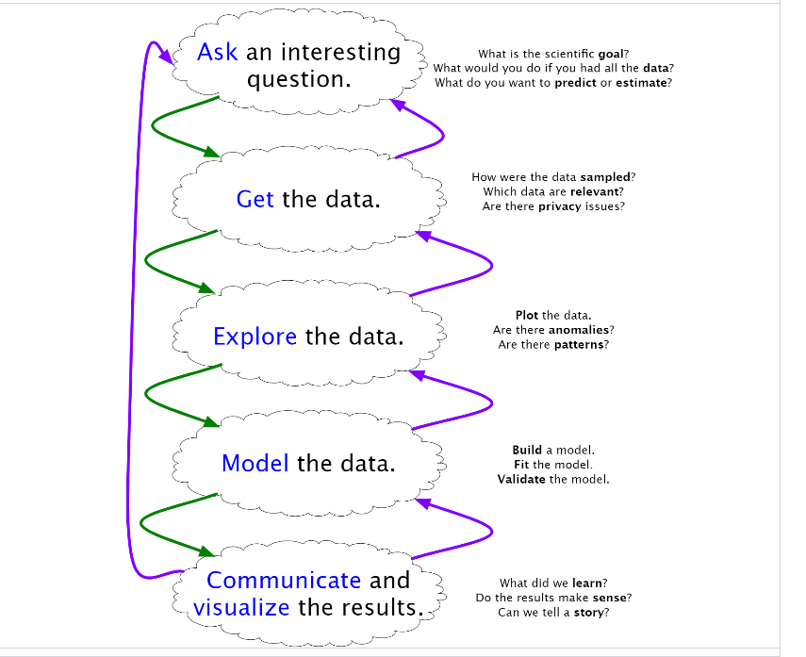
Data Science
Data Science Pipeline
Although similar to the traditional statistics, the data science pipeline has its own unique features. Everything starts with a question, it is important to frame questions through scientific lens and it can be solved through data science. The data is perhaps the most important component, for it will be the difference between quality or poor results; with data there comes the necessity to find it, process it and modify it in a manner congruent with its eventual use. At this stage, it is a good idea to explore the data, so as to get better acquainted with any patterns or anomalies to account for in latter stages. The heart of data science is indeed modeling - the application of automatic statistical learning. Finally,
Notes:
Additional Resources to check out
- KD Nuggets https://www.kdnuggets.com/2018/05/beginners-guide-data-science-pipeline.html
- GEEKS 4 GEEKS https://www.geeksforgeeks.org/whats-data-science-pipeline/
- IBM https://developer.ibm.com/articles/ba-intro-data-science-1/

Slide 44
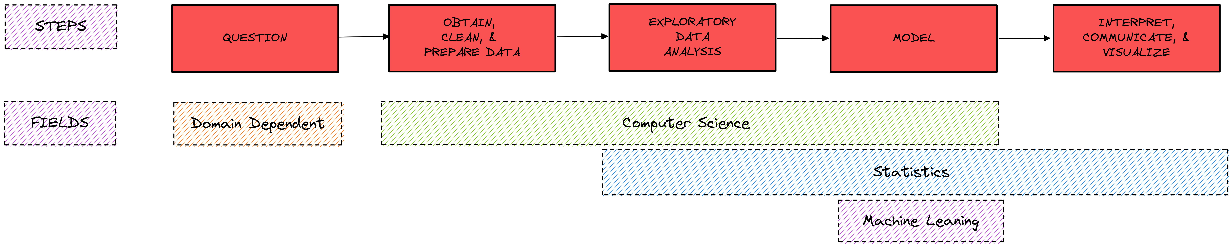
Data Science
Data Science Pipeline

Slide 45
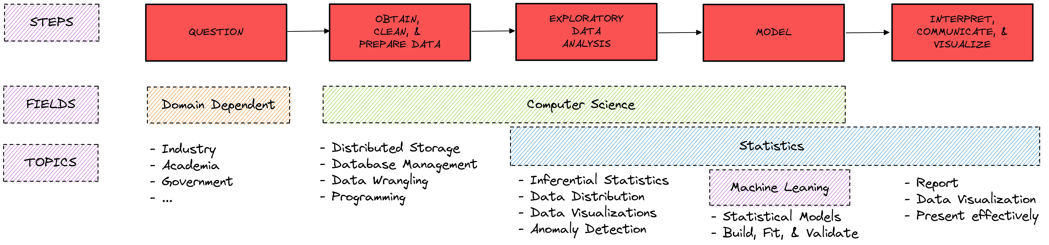
Data Science
Data Science Pipeline

Slide 46
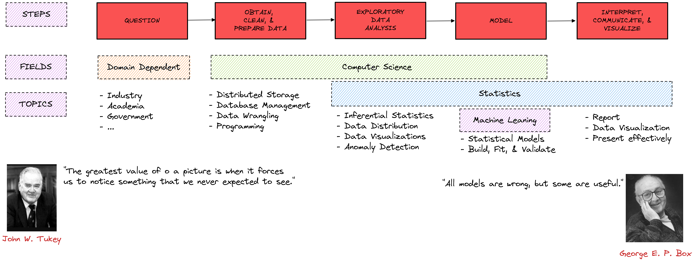
Data Science
Data Science Pipeline

Slide 47
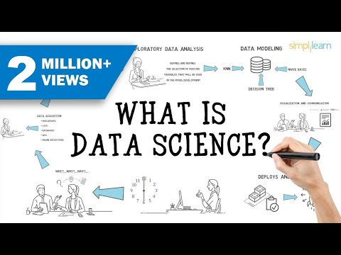
Data Science
Still Confused?
Watch this video.
Notes:
Further Resources
https://www.youtube.com/watch?v=UiV7wf36je0&t=145s & https://www.techtarget.com/searchenterpriseai/definition/data-science
https://www.youtube.com/watch?v=uswU1s3M2VE

Slide 48
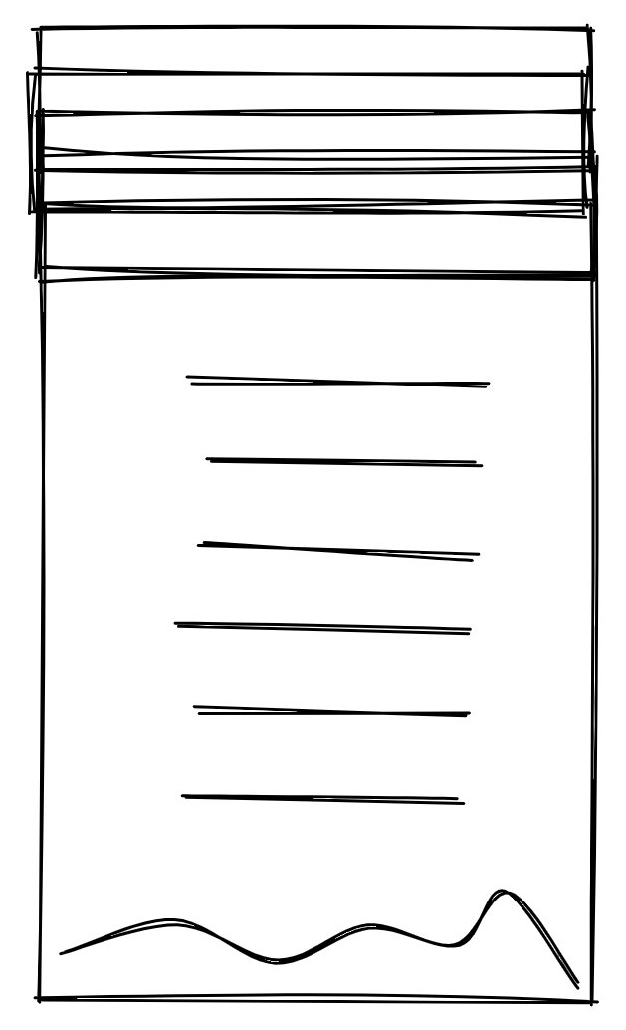
Data Science
Further Resources
Data Science
https://www.oracle.com/data-science/what-is-data-science/
https://ischoolonline.berkeley.edu/data-science/what-is-data-science-2/
https://en.wikipedia.org/wiki/Data_science
https://www.simplilearn.com/tutorials/data-science-tutorial/what-is-data-science
https://www.tibco.com/reference-center/what-is-data-science
https://www.ibm.com/cloud/learn/data-science-introduction
https://developer.ibm.com/articles/ba-intro-data-science-1/
https://hbr.org/2012/10/data-scientist-the-sexiest-job-of-the-21st-century
https://www.heavy.ai/learn/data-science
Notes:
Further Explanation

